Slide 1
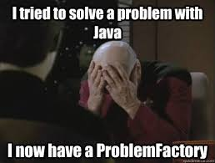
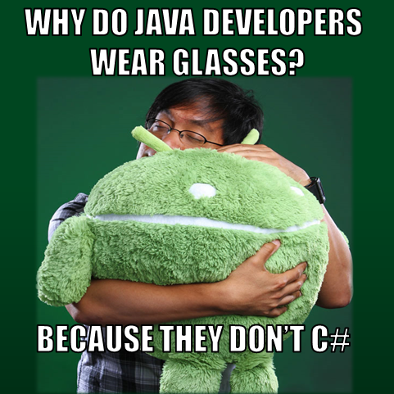
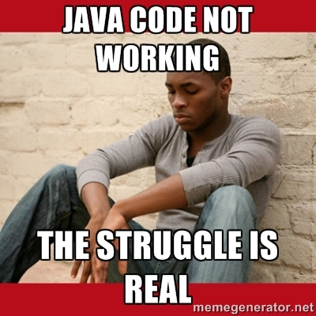
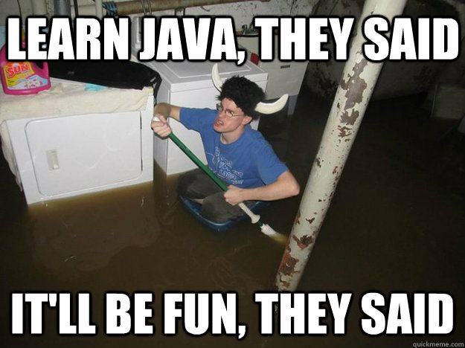
Java

Slide 2

ABout Me
Name
Major
CS Courses Taken
A fun fact

Slide 3

Show of Hands of people that have Java Running on their computer

Slide 4
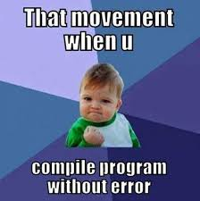
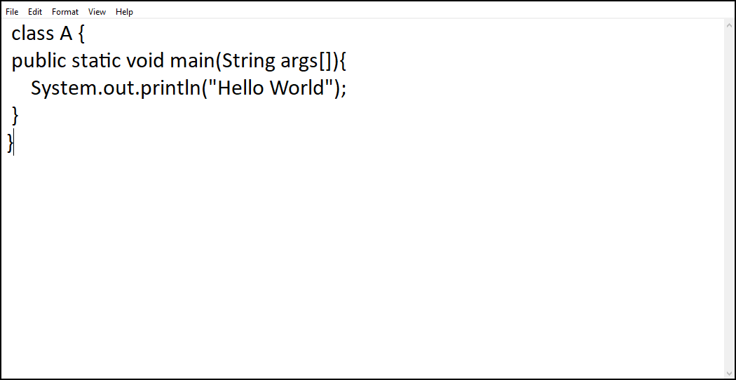
The Hell0 W0rld Pr0gram

Slide 5
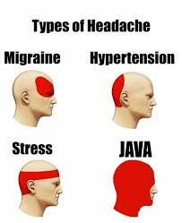

Slide 6

Accessing Program from Command Line
Open command prompt by typing cmd into the search bar
For Windows, type in “dir” or “ls” on Mac OS
You should see all the files
Change your directory based on where you kept your java file
Type javac (FileName).java and press enter
Type java (FileName) and press enter
You should be seeing the output of your first program

Slide 7
Questions???

